Slide 1
OPEN SOURCE LARGE LANGUAGE MODELS

Slide 2
What is Large Language Model?
A large language model refers to a sophisticated artificial intelligence system designed to understand and generate human-like text based on the input it receives. These models are trained on vast amounts of text data and use deep learning techniques to analyze and generate coherent and contextually relevant responses.
Large language models, such as OpenAI's GPT-3 (Generative Pre-trained Transformer 3), consist of millions or even billions of parameters, enabling them to learn complex patterns and relationships within the data they are trained on. They can understand and generate text in multiple languages, perform a wide range of natural language processing tasks, and engage in conversational interactions with users.
These models have been trained on diverse sources of data, including books, articles, websites, and other text-based materials. They can answer questions, provide explanations, generate creative content, assist with language translation, and much more. Large language models have the potential to enhance various applications, including chatbots, virtual assistants, content generation, language translation, and even creative writing.

Slide 3
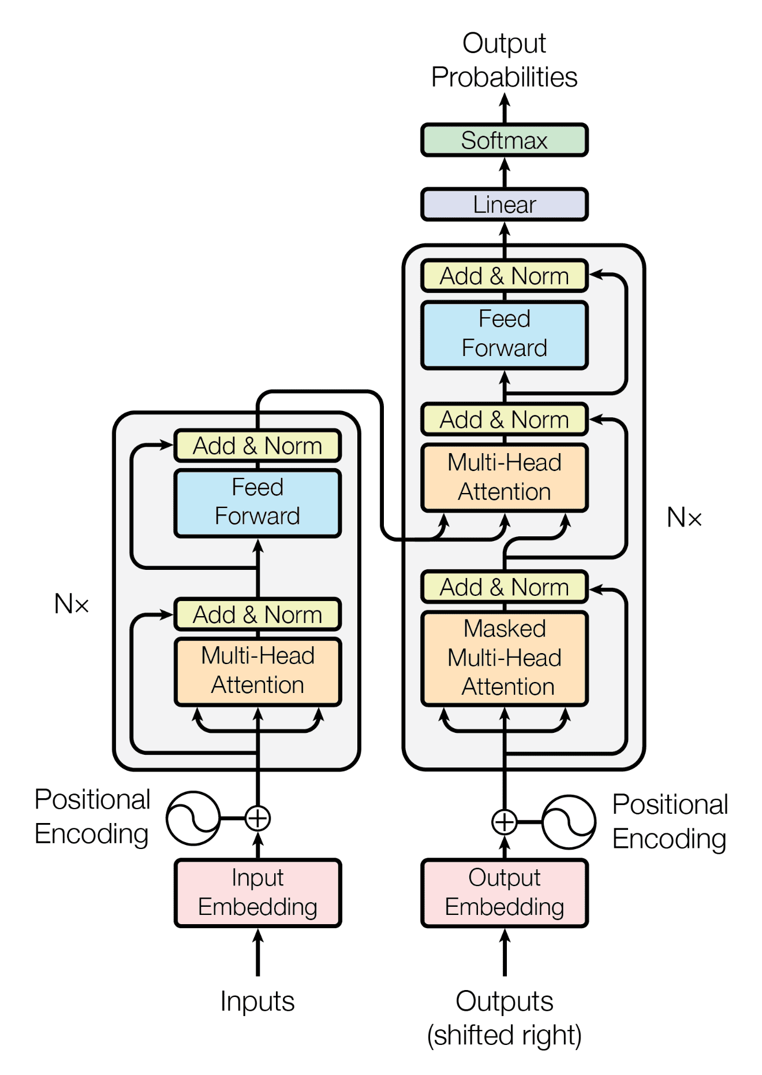
Transformers Architecture
The Transformer architecture is a deep learning model introduced in the "Attention is All You Need" paper by Vaswani et al. It's designed for sequential tasks like machine translation, text generation, and language understanding. Transformers use self-attention mechanisms to process input data, enabling parallel computation and capturing long-range dependencies effectively. The model consists of an encoder and a decoder, both composed of multiple layers of self-attention and feed-forward neural networks. The self-attention mechanism allows the model to focus on relevant parts of the input sequence when generating each output token. This architecture revolutionized natural language processing tasks and has become a foundation for many state-of-the-art models.

Slide 4
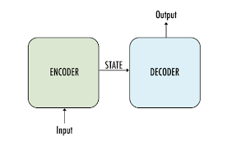
Types of LLM Models
Encoder-Decoder only Models
An Encoder-Decoder model combines both encoding and decoding components to handle sequence-to-sequence tasks, where the input and output sequences have different lengths.
The model has two main parts: an encoder and a decoder. The encoder processes the input sequence and generates a fixed-length representation (context vector), which captures the essential information from the input. The decoder takes this context vector and generates the output sequence step by step, token by token, based on the information from the encoder.
Tasks including Machine translation, Text summarization, Question answering, Code generation, etc.,
Example:
-> Google Flan-T5 Family
-> BART

Slide 5
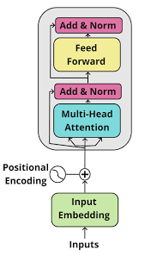
Types of LLM Models
Encoder-only Models
The primary function of an encoder-only model is to process the input sequence and create a fixed-size representation (also known as an embedding) that captures the contextual information and semantic meaning of the input.
It is commonly used for tasks that involve extracting meaningful features from the input data.
It cannot generate text outputs but it can be fine-tuned to perform specific tasks.
Tasks including Text Classification, Sentiment Analysis, Feature Extraction, etc.,
Example:
-> Bert
-> Distilbert
-> ALBERT

Slide 6
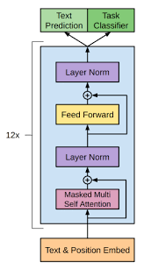
Types of LLM Models
Decoder-only Models
A Decoder-Only model is used for generating sequences or text outputs. It is employed in autoregressive tasks, where the model generates one token at a time based on the previously generated tokens.
The decoder-only model works by first taking the input sequence and converting it into a sequence of token embeddings. These token embeddings are then passed through a series of self-attention layers, which enabling the model to focus on relevant parts of the input sequence. The output of the self-attention layers is then passed through a feed-forward network, which generates a probability distribution over the next token in the output sequence.
Tasks including Text generation, Machine translation, Image generation, Code generation, etc.,
Example:
-> GPT Family(GPT-2,GPT-3)
-> Falcon models
-> bigscience/bloom-560m

Slide 7
Open-Source Model’s Used
Text2Text Generation | License
google/flan-t5-small | Apache 2.0
google/flan-t5-base | Apache 2.0
google/flan-t5-large | Apache 2.0
declare-lab/flan-alpaca-base | Apache 2.0
declare-lab/flan-alpaca-large | Apache 2.0
google/long-t5-tglobal-base | Apache 2.0
Text Generation | License
bigscience/bloom-560m | RAIL License v1.0
gpt2-medium | mit
EleutherAI/pythia-70m | Apache 2.0
distilbert-base-uncased | Apache 2.0
Bert-base-uncased | Apache 2.0

Slide 8
LLM Model's Criteria
These LLM models were chosen because studies have demonstrated that they perform well on a wide range of NLP tasks, including as text production, question answering, and summarization.
These models are also open-source, which makes them accessible to researchers and developers.
Since these models have less than 1 billion parameters, they could be downloaded, used locally, and fine-tuned for future tasks.

Slide 9
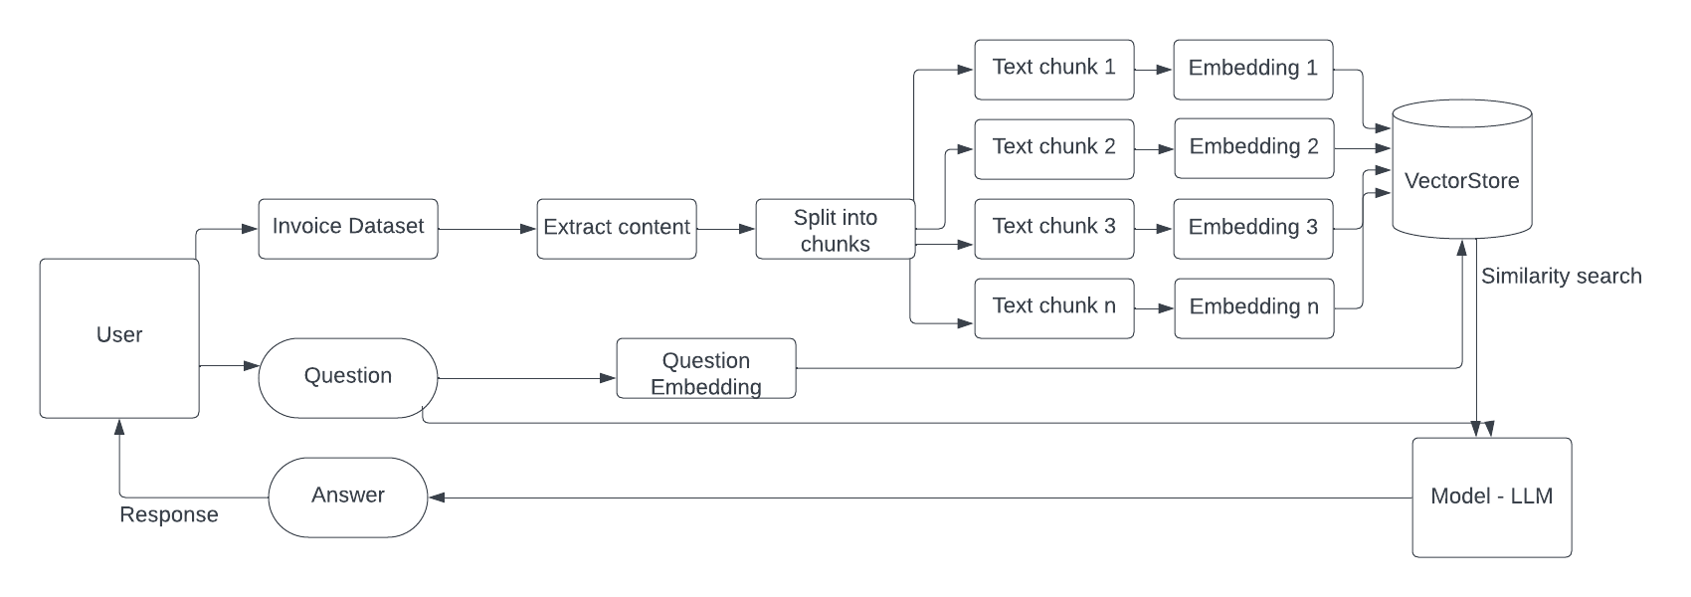
LangChain
LangChain is a framework designed to simplify the creation of applications using large language models. As a language model integration framework, LangChain use-cases largely overlap with those of language models in general, including document analysis and summarization, chatbots, and code analysis.

Slide 10
Computational Resources
Google Colab :
CPU : The default CPU for Colab is an Intel Xeon CPU [2-core Xeon 2.2GHz] with 2 vCPUs (virtual CPUs) and 13GB of RAM.
GPU : The default GPU for Colab is a NVIDIA Tesla K80 with 12GB of VRAM (Video Random-Access Memory).
DISK : Colab has a disk space limitation of 108 GB, of which only 77 GB is available to the user.

Slide 11
Invoice Question Answering
Double click to view the PDF

Slide 12
Invoice Questions
Questions​ | Actual Answers​
What is the Invoice number?​ | ​Invoice number: INV-3337
What is the Invoice date?​ | Invoice date: January 25, 2016
What is the total amount?​ | ​Total Due: $93.50
State the From address of Invoice?​ | ​From address of Invoice: DEMO - Sliced Invoices Suite 5A-1204 123 Somewhere Street Your City AZ 12345
State the To address of Invoice? | ​To address of Invoice: Test Business 123 Somewhere St Melbourne, VIC 3000
What is the order number? | ​Order number mentioned in the Invoice: 12345

Slide 13
Model​ | google/flan-t5-small​ | google/flan-t5-base​ | google/flan-t5-large
What is the Invoice number?​ | ​12345 | INV-3337​ | ​INV-3337
What is the Invoice date?​ | ​25-Jan-16 | 25-Jan-16​ | ​25-Jan-16
What is the total amount?​ | ​Total Due | $93.5​ | ​$93.5
State the From address of Invoice?​ | ​123 Somewhere Street Your City AZ 12345 admin@slicedinvoices.com Order Number 12345 | DEMO - Sliced Invoices Suite 5A-1204 123 Somewhere Street YourCity AZ12345 admin@slicedinvoices.com | ​DEMO - Sliced Invoices Suite 5A-1204 123 Somewhere Street Your City AZ12345 admin@slicedinvoices.com
State the To address of Invoice?​ ​ | ​123 Somewhere Street Your City AZ 12345 admin@slicedinvoices.com | ​123 Somewhere Street Your City AZ 12345 admin@slicedinvoices.com | ​Test Business 123 Somewhere St Melbourne, VIC 3000 test@test.com
What is the order number?​ | ​12345 | ​12345 | ​12345
Score​ | 7.16 | 9 | 9

Slide 14
Model​ | declare-lab/flan-alpaca-base​ | declare-lab/flan-alpaca-large | google/long-t5-tglobal-base
What is the Invoice number?​ | ​The Invoice Number is INV-3337. | ​INV-3337 | ​INV-3337
What is the Invoice date?​ | ​The Invoice date is January 25, 2016. | ​The Invoice date is January 25, 2016. | ​Invoice Date January 25, 2016
What is the total amount?​ | ​The total due is $93.50. | ​Total Due $93.50 | ​Total Due $93.50
State the From address of Invoice?​ | ​The From address of the Invoice is: 123 Somewhere Street, Your City AZ. | DEMO - Sliced Invoices Suite 5A-1204 123 Somewhere Street Your City AZ 12345 | ​ From address of Invoice
State the To address of Invoice?​ ​ | ​The To address of the Invoice is: 123 Somewhere Street, Your City AZ. | ​Test Business 123 Somewhere St Melbourne, VIC 3000 | ​To address of Invoice
What is the order number?​ | ​The Order number mentioned in this Invoice is 12345. | ​The Order Number mentioned in this Invoice is 12345. | ​Order number
Score​ | 9 | 9 | 7.5

Slide 15
Model​ | bigscience/bloom-560M | gpt2-medium | EleutherAI/pythia-70m
What is the Invoice number?​ | ​The invoice number is the number of the invoice that was sent to the customer. | INV-3337​ | ​Invoice Number INV-3338
What is the Invoice date?​ | ​The invoice date is the date the invoice was received by the customer. | January 31, 2016. | ​The Invoice Date January 25, 2016
What is the total amount?​ | ​Sub Total $85.00 | Total Due is equal to 15% of all of the products produced prior to January 1 of a certain. | ​Payment is due within 30 days from date of invoice
State the From address of Invoice?​ | ​From: INV-3337 To: INV-3337 | Total Due is equal to 15% of all of the products produced prior to January 1 of a certain date. | State the From address of Invoice? State the To address of Invoice?
State the To address of Invoice?​ | ​From: INV-3337 To: INV-3338 | ​Sub Total Tax Amount ($90 - 89) Total TOTAL $85.00 | ​State the From address of Invoice?
What is the order number?​ | ​3337 | ​You may add your own invoice number in the box below Enter an invoice for £15. | ​
Score​ | 6.16 | 6.5 | 6.5

Slide 16
Model​ | OpenAI's ChatGPT | Google's Bard​
What is the Invoice number?​ | Invoice number: INV-3337 | Invoice number: INV-3337
What is the Invoice date?​ | Invoice date: January 25, 2016 | Invoice date: January 25, 2016
What is the total amount?​ | Total Due: $93.50 | Total due: $93.50
State the From address of Invoice?​ | From address of Invoice: DEMO - Sliced Invoices Suite 5A-1204 123 Somewhere Street Your City AZ 12345 | From address: DEMO - Sliced Invoices, Suite 5A-1204, 123 Somewhere Street, Your City AZ 12345
State the To address of Invoice?​ ​ | To address of Invoice: Test Business 123 Somewhere St Melbourne, VIC 3000 | To address: Test Business, 123 Somewhere St, Melbourne, VIC 3000
What is the order number?​ | Order number mentioned in the Invoice: 12345 | Order number: 12345
Score​ | 9 | 9

Slide 17
Text2Text Generation - Performance
Model Name​ | Parameter Size | Model Size | Performance​ |  |  | Average Execution Time (sec)
 |  |  | RAM​ (13GB) | GPU (15GB)​ | Disk (78.2GB)​
google/flan-t5-small​ | 80M | 0.2868 GB | ​4.8 GB | 2.2 GB​ | 1.99 GB​ | ​0.25
google/flan-t5-base​ | 248M | 0.9224 GB | ​4.8 GB | ​3 GB | ​2.98 GB | 0.83
google/flan-t5-large​ | 783M | 2.9177 GB | ​5 GB | ​5.1 GB | ​6.97 GB | 0.65
declare-lab/flan-alpaca-base​ | 248M | 0.9224 GB | ​4.8 GB | ​3 GB | ​3.27 GB | 0.53
declare-lab/flan-alpaca-large​ | 783M | 2.9177 GB | ​5 GB | ​5.1 GB | ​7.26 GB | 0.66
google/long-t5-tglobal-base​ | 250 M | 1.1063 GB | ​4.7 GB | 3.2 GB​ | 3.45 GB​ | 1.52​

Slide 18
Text Generation - Performance
Model Name​ | Parameter Size | Model Size | Performance​ |  |  | Average Execution Time (sec)
 |  |  | RAM​ (13GB) | GPU (15GB)​ | Disk (78.2GB)​
bigscience/bloom-560m | 560M | 2.0833 GB | ​8.7 GB | ​2 GB | ​4.56 GB | ​25.81
gpt2-medium | 355M | 1.3219 GB | 7.2 GB | 2 GB | 4.16 GB | 11.4
EleutherAI/pythia-70m | 70M | 0.2624 GB | 5 GB | 2 GB | 1.84 GB | 1.67

Slide 19
Summary
Based on the above data, the best model based on both accuracy and performance is declare-lab/flan-alpaca-base. It has a high accuracy score of 9, and it is also relatively fast, with an average execution time of 0.53 seconds. The second-best model is google/flan-t5-large, which also has a high accuracy score of 9, but it is slightly slower, with an average execution time of 0.65 seconds.
The other models on the list have lower accuracy scores or are slower than the top two models. For example, bigscience/bloom-560m has a high parameter size of 560M, but its accuracy score is only 6.16. And gpt2-medium has a high accuracy score of 6.5, but it is relatively slow, with an average execution time of 11.4 seconds.
Overall, the best model based on both accuracy and performance is declare-lab/flan-alpaca-base. It is a good choice for tasks that require both high accuracy and fast performance.

Slide 20
Document Question Answering
Double click to view PDF

Slide 21
Document Question Answering
Questions​ | Actual Answers​
What is Artificial Intelligence? | ​Artificial Intelligence (AI) refers to the simulation of human intelligence in machines that are programmed to think and act like humans. It involves the development of algorithms and computer programs that can perform tasks that typically require human intelligence such as visual perception, speech recognition, decision -making, and language translation. AI has the potential to revolutionize many industries and has a wide range of applications, from virtual personal assistants to self -driving cars.
What is Intelligence? | Intelligence is the ability to learn and solve problems.
What is Intelligence is composed of? | ​Intelligence is composed of Reasoning, Learning, Problem -Solving , Perception, and Linguistic Intelligence.
List any Four uses of Artificial Intelligence? | ​Uses of Artificial Intelligence: 1. Healthcare, 2. Finance, 3. Retail, 4. Manufacturing
Need of Artificial Intelligence? | ​The need for Artificial Intelligence is to improve efficiency, better decision-making, enhanced accuracy, exploration of new frontiers and personalization.
Explain Robotics technology in Artificial Intelligence? | ​Robotics technology is used in Artificial Intelligence to automate tasks in manufacturing, healthcare, retail, and other industries.

Slide 22
Questions | google/flan-t5-base | google/flan-t5-small
What is Artificial Intelligence? | ​ The ability to learn and solve problems. | The ability to learn and solve problems.
What is Intelligence? | The ability to learn and solve problems. | The ability to learn and solve problems.
What is Intelligence is composed of? | ​Reasoning, Learning, Problem-Solving, Perception, Linguistic Intelligence | Reasoning • Learning • Problem -Solving • Perception • Linguistic Intelligence Uses of Artificial Intelligence
List any Four uses of Artificial Intelligence? | Health care | Artificial Intelligence
Need of Artificial Intelligence? | ​human intelligence | Artificial Intelligence
Explain Robotics technology in Artificial Intelligence? | ​AI-powered robots and automation systems that can perform tasks in manufacturing, healthcare, retail, and other industries. | Artificial Intelligence is a term used to describe the simulation of human intelligence in machines that are programmed to think and act like humans.
Score​ | 5.94 | 5

Slide 23
Questions | google/flan-t5-large
What is Artificial Intelligence? | ​the simulation of human intelligence in machines that are programmed to think and act like humans
What is Intelligence? | The ability to learn and solve problems.
What is Intelligence is composed of? | ​Reasoning • Learning • Problem -Solving • Perception • Linguistic Intelligence
List any Four uses of Artificial Intelligence? | Retail: AI is used for product recommendations, price optimization, and supply chain management.
Need of Artificial Intelligence? | ​1. Improved efficiency 2. Better decision -making 3. Enhanced accuracy 4. Personalization 5. Exploration of new frontier s Technologies Based on Artificial Intelligence
Explain Robotics technology in Artificial Intelligence? | ​AI-powered robots and automation systems that can perform tasks in manufacturing, healthcare, retail, and other industries.
Score​ | 7.22

Slide 24
Questions | declare-lab/flan-alpaca-base
What is Artificial Intelligence? | ​Artificial Intelligence (AI) refers to the simulation of human intelligence in machines that are programmed to think and act like humans. It involves the development of algorithms and computer programs that can perform tasks that typically require human intelligence such as visual perception, speech recognition, decision -making, and language translation. AI has the potential to revolutionize many industries and has a wide range of applications, from virtual personal assistants to self -driving cars.
What is Intelligence? | ​Intelligence is the ability to learn and solve problems.
What is Intelligence is composed of? | ​Intelligence is composed of: • Reasoning • Learning • Problem -Solving • Perception • Linguistic Intelligence.
List any Four uses of Artificial Intelligence? | 1. Health care 2. Finance 3. Banking 4. Manufacturing 5. Transportation 6. Customer service 7. Chatbots 8. Education 9. Personalization
Need of Artificial Intelligence? | ​The need for Artificial Intelligence is a growing need for more efficient and effective solutions to complex problems.
Explain Robotics technology in Artificial Intelligence? | ​Artificial Intelligence (AI) refers to the simulation of human intelligence in machines that are programmed to think and act like humans. It involves the development of algorithms and computer programs that can perform tasks that typically require human intelligence such as visual perception, speech recognition, decision -making, and language translation. AI has the potential to revolutionize many industries and has a wide range of applications, from virtual personal assistants to self -driving cars.
Score​ | ​8.72

Slide 25
Questions | declare-lab/flan-alpaca-large
What is Artificial Intelligence? | ​Artificial Intelligence (AI) refers to the simulation of human intelligence in machines that are programmed to think and act like humans. It involves the development of algorithms and computer programs that can perform tasks that typically require human intelligence such as visual perception, speech recognition, decision -making, and language translation. AI has the potential to revolutionize many industries and has a wide range of applications, from virtual personal assistants to self -driving cars.
What is Intelligence? | ​Intelligence is the ability to learn and solve problems.
What is Intelligence is composed of? | ​Intelligence is composed of: • Reasoning • Learning • Problem -Solving • Perception • Linguistic Intelligence.
List any Four uses of Artificial Intelligence? | 1. Health care: AI is used for medical diagnosis, drug discovery, and predictive analysis of diseases. 2. Finance: AI helps in credit scoring, fraud detection, and financial forecasting. 3. Retail: AI is used for product recommendations, price optimization, and supply chain management. 4. Manufacturing: AI helps in quality control, predictive maintenance, and production optimization.
Need of Artificial Intelligence? | ​The need for Artificial Intelligence is to improve efficiency, reduce costs, and increase accuracy.
Explain Robotics technology in Artificial Intelligence? | ​Robotics technology is used in Artificial Intelligence to automate tasks in manufacturing, healthcare, retail, and other industries. It is used to process data and make predictions or decisions without being explicitly programmed.
Score​ | ​9

Slide 26
Questions | google/long-t5-tglobal-base
What is Artificial Intelligence? | ​It involves the development of algorithms and computer programs that can perform tasks that typically require human intelligence such as visua l perception, speech recognition, decision -making, and language translation. Intelligence is composed of: • Reasoning • Learning • Problem -Solving • Perception • Linguistic Intelligence Uses of Artificial Intelligence : Artificial Intelligence has many practical applications across various industries and domains, including:
What is Intelligence? | It involves the development of algorithms and computer programs that can perform tasks that typically require human intelligence such as visua l perception, speech recognition, decision -making, and language translation.
What is Intelligence is composed of? | ​It involves the development of algorithms and computer programs that can perform tasks that typically require human intelligence such as visua l perception, speech recognition, decision -making, and language translation. Intelligence is composed of: • Reasoning • Learning • Problem -Solving • Perception • Linguistic Intelligence Uses of Artificial Intelligence : Artificial Intelligence has many practical applications across various industries and domains, including:
List any Four uses of Artificial Intelligence? | • Reasoning • Learning • Problem -Solving • Perception • Linguistic Intelligence Uses of Artificial Intelligence : Artificial Intelligence has many practical applications across various industries and domains, including:
Need of Artificial Intelligence? | ​It involves the development of algorithms and computer programs that can perform tasks that typically require human intelligence such as visua l perception, speech recognition, decision -making, and language translation.
Explain Robotics technology in Artificial Intelligence? | ​It involves the development of algorithms and computer programs that can perform tasks that typically require human intelligence such as visua l perception, speech recognition, decision -making, and language translation.
Score​ | ​7

Slide 27
Questions | bigscience/bloom-560M
What is Artificial Intelligence? | How can Artificial Intelligence be used to improve the performance of a computer system?
What is Intelligence? | Intelligence is the ability to learn and solve problems. This definition is taken from webster’s Dictionary.
What is Intelligence is composed of? | Intelligence is composed of: Reasoning Learning Problem-Solving Perception Linguistic Intelligence
List any Four uses of Artificial Intelligence? | 1. Healthcare: AI is used for medical diagnosis, drug discovery, and predictive analysis of diseases. 2. Marketing: AI is used for targeted advertising, customer segmentation, and sentiment analysis. 3. Transportation: AI is used for autonomous vehicles, traffic prediction, and route optimization. 4. Transportation: AI is used for autonomous vehicles, traffic prediction, and route optimization. 5. Transportation: AI is used for autonomous vehicles, traffic prediction, and route optimization. 6. Transportation: AI is used for autonomous vehicles, traffic prediction, and route optimization. 7.. Transportation: AI is used for autonomous vehicles, traffic prediction
Need of Artificial Intelligence? | The term Artificial Intelligence is used to describe the process of learning and understanding human behavior. It is a branch of computer science that studies the use of artificial intelligence to solve problems. It is a branch of computer science that studies the use of artificial intelligence to solve problems. It is a branch of computer science that studies the use of artificial intelligence to solve
Explain Robotics technology in Artificial Intelligence? | The robotics field is a branch of computer science that studies the use of computers to solve problems in the field of computer science. The field is concerned with the development of computer systems that can perform tasks that require human intelligence. The field is also concerned with the development of computer systems that can
Score​ | ​5.11

Slide 28
Questions | gpt2-medium | EleutherAI/pythia-70m
What is Artificial Intelligence? | Artificial Intelligence refers to the simulation of human intelligence in machines that are programmed to think and act like humans. It involves the development of algorithms and computer programs that can perform tasks that typically require humanogi | Machine Learning: A subfield of AI that uses algorithms to enable
What is Intelligence? | ​Intelligence is the ability to learn and solve problems. | The ability to learn and solve problems. This definition is taken from webster’s Dictionary.
What is Intelligence is composed of? | ​Intelligence is composed of: • Reasoning • Learning • Problem -Solving • Perception • Linguistic Intelligence. | Intelligence is composed of: Reasoning • Learning • Problem-Solving • Perception • Linguistic Intelligence
List any Four uses of Artificial Intelligence? | 1. Advanced healthcare: AI is used for advanced medical diagnosis and precision medical diagnosis at the individual level. 2. Advanced analytics: AI is used for analyzing and creating predictive models. 3. Personalization: AI is used to create personalized experiences based on individual needs. 4. Behavioral analysis: AI is used to analyze behavior patterns, behaviors, and thoughts to create personalized experiences based on individual needs. | Artificial Intelligence is used for personalized learning, adaptive testing, and intelligent tutoring systems.
Need of Artificial Intelligence? | Yes, but you don't have to learn it all. 2. AI for Education: Artificial Intelligence is used for personalized learning, adaptive testing, and intelligent tutoring systems. | AI is used for personalized learning, adaptive testing, and intelligent tutoring systems. 2. Machine Learning: A subfield of AI that uses algorithms to enable
Explain Robotics technology in Artificial Intelligence? | AI is a subfield of Artificial Intelligence that deals with the processing and | AI is used for personalized learning, adaptive testing, and intelligent tutoring systems. 4. Robotics: AI-powered robots and automation systems that can perform tasks in manufacturing
Score​ | 6.6 | 6.6

Slide 29
Questions | OpenAI's ChatGPT
What is Artificial Intelligence? | Artificial Intelligence (AI) refers to the simulation of human intelligence in machines that are programmed to think and act like humans. It involves the development of algorithms and computer programs that can perform tasks that typically require human intelligence.
What is Intelligence? | ​Intelligence is the ability to learn and solve problems.
What is Intelligence is composed of? | ​Intelligence is composed of reasoning, learning, problem-solving, perception, and linguistic intelligence.
List any Four uses of Artificial Intelligence? | a) Healthcare: Medical diagnosis, drug discovery, and predictive analysis of diseases. b) Finance: Credit scoring, fraud detection, and financial forecasting. c) Retail: Product recommendations, price optimization, and supply chain management. d) Manufacturing: Quality control, predictive maintenance, and production optimization.
Need of Artificial Intelligence? | Need for Artificial Intelligence are Improved efficiency, Better decision-making, Enhanced accuracy,Personalization, Exploration of new frontiers
Explain Robotics technology in Artificial Intelligence? | Robotics technology in Artificial Intelligence involves the use of AI-powered robots and automation systems. These robots are designed to perform tasks in various industries, such as manufacturing, healthcare, and retail.
Score​ | ​9

Slide 30
Questions | Google's Bard
What is Artificial Intelligence? | Artificial Intelligence (AI) is the simulation of human intelligence in machines that are programmed to think and act like humans. It involves the development of algorithms and computer programs that can perform tasks that typically require human intelligence such as visual perception, speech recognition, decision-making, and language translation.
What is Intelligence? | Intelligence is the ability to learn and solve problems.
What is Intelligence is composed of? | Reasoning: The ability to think logically and make inferences. Learning: The ability to acquire new knowledge and skills. Problem-Solving: The ability to identify and solve problems. Perception: The ability to interpret and understand sensory information.Linguistic Intelligence: The ability to understand and use language.
List any Four uses of Artificial Intelligence? | Healthcare: AI is used for medical diagnosis, drug discovery, and predictive analysis of diseases. Finance: AI helps in credit scoring, fraud detection, and financial forecasting. Retail: AI is used for product recommendations, price optimization, and supply chain management. Manufacturing: AI helps in quality control, predictive maintenance, and production optimization.
Need of Artificial Intelligence? | Improved efficiency: AI can help to improve efficiency in many industries by automating tasks and making decisions more quickly. Better decision-making: AI can help to make better decisions by providing insights that would not be possible for humans to identify. Enhanced accuracy: AI can help to enhance accuracy by identifying patterns and trends that would not be visible to humans. Personalization: AI can help to personalize products and services by understanding the individual needs of each customer. Exploration of new frontiers: AI can help to explore new frontiers by solving problems that are too difficult or dangerous for humans to solve.
Explain Robotics technology in Artificial Intelligence? | Robotics is a field of AI that deals with the development of AI-powered robots and automation systems that can perform tasks in manufacturing, healthcare, retail, and other industries.
Score​ | ​9

Slide 31
Text2Text Generation - Performance
Model Name​ | Parameter Size | Model Size l | Performance​ |  |  | Average Execution Time (sec)
 |  |  | RAM (13GB) | GPU (15GB)​ | Disk (78.2GB)​
google/flan-t5-small​ | 80M | 0.2868 GB | ​5.1 GB | ​2.2 GB | 1.99 GB​ | ​0.32
google/flan-t5-base​ | 248M | 0.9224 GB | 4.8 GB | 3.0 GB | ​2.98 GB | 0.43
google/flan-t5-large​ | 783M | 2.9177 GB | 4.5 GB | 5.1 GB | ​6.97 GB | 0.73
declare-lab/flan-alpaca-base​ | 248M | 0.9224 GB | 4.9 GB | 3.0 GB | ​3.27 GB | 1.80
declare-lab/flan-alpaca-large​ | 783M | 2.9177 GB | 4.5 GB | 5.1 GB | ​7.26 GB | 1.54
google/long-t5-tglobal-base​ | 250 M | 1.1063 GB | ​4.9 GB | 3.2 GB​ | 3.45 GB​ | ​0.98

Slide 32
Text Generation - Performance
Model Name​ | Parameter Size | Model Size | Performance​ |  |  | Average Execution Time (sec)
 |  |  | RAM (13GB) | GPU (15GB)​ | Disk (78.2GB)​
bigscience/bloom-560m | 560M | 2.0833 GB | ​8.4 GB | 4.2​ GB | ​4.56 GB | ​23.76
gpt2-medium | 355M | 1.3219 GB | 7.1 GB | 2.2 GB | 4.16 GB | 14.12
EleutherAI/pythia-70m | 70M | 0.2624 GB | 3.1 GB | 2.2 GB | 1.84 GB | 1.89

Slide 33
Summary
The best model based on both accuracy and performance is declare-lab/flan-alpaca-large. It has the highest accuracy score of 9, and its average execution time is only 1.54 seconds, which is faster than all other models with comparable accuracy. The second-best model is google/flan-t5-large, which has an accuracy score of 7.22 and an average execution time of 0.73 seconds.
The gpt2-medium and EleutherAI/pythia-70m models have similar accuracy scores of 6.6, but the EleutherAI/pythia-70m model is slightly faster, with an average execution time of 1.89 seconds. The EleutherAI/pythia-70m model is the smallest model in this list, with a parameter size of only 70M. This makes it a good choice if you are limited on resources. The bigscience/bloom-560m model has the lowest accuracy score of 5.11, and a very high average execution time of 23.76 seconds.
Overall, the declare-lab/flan-alpaca-large model is the best text2text generation model based on both accuracy and performance. It has the highest accuracy score and is one of the fastest models in this list.

Slide 34
Generic Question Answering

Slide 35
Generic Question Answering
Questions​ | Actual Answers​
What is the capital of France? | The capital of France is Paris.
How many days are there in a week? | There are seven days in a week / There are 7 days in a week
What is the largest planet in our solar system? | The largest planet in our solar system is Jupiter.
What is the tallest mountain in the world? | The tallest mountain in the world is Mount Everest.
What is the main language in Spain? | The main language in Spain is Spanish.
Who is the author of Harry Potter book series? | The author of the Harry Potter book series is J.K. Rowling.

Slide 36
Questions | google/flan-t5-small | google/flan-t5-base | google/flan-t5-large
What is the capital of France? | ​ France | Paris | Paris
How many days are there in a week? | 7 | 7 days | 7
What is the largest planet in our solar system? | Pluto | Venus | Jupiter
What is the tallest mountain in the world? | Mount Everest | st johns | Mount Everest
What is the main language in Spain? | Spanish Language | Spanish | Spanish Language
Who is the author of Harry Potter book series? | Harry Potter | john scott | J. K. Rowling
Score​ | 4.8 | 7 | 9

Slide 37
Model​ | declare-lab/flan-alpaca-base​ | declare-lab/flan-alpaca-large | google/long-t5-tglobal-base
What is the capital of France? | The capital of France is Paris. | The capital of France is Paris. | What is the capital of France?
How many days are there in a week? | There are approximately 365 days in a week. | There are seven days in a week. | How many days are there in a week?
What is the largest planet in our solar system? | The largest planet in our solar system is Mercury, which is the second-largest planet in the Solar System. | The largest planet in our solar system is Mercury, with an area of approximately 1.4 Earth's radius. | What is the largest planet in our solar system?
What is the tallest mountain in the world? | The tallest mountain in the world is Mount Everest, located in the Himalayas, in Nepal. | The tallest mountain in the world is Mount Everest, located in Nepal. It is the highest mountain in the world, standing at 8,848 meters (29,029 feet). | What is the tallest mountain in the world?
What is the main language in Spain? | The main language in Spain is Spanish. | The main language in Spain is Spanish. | What is the main language in Spain?
Who is the author of Harry Potter book series? | The author of Harry Potter book series is J.K. Rowling. | The author of Harry Potter book series is J.K. Rowling. | Harry Potter book series.
Score​ | 7.3 | 8.2 | 8.2

Slide 38
Model​ | bigscience/bloom-560M | gpt2-medium | EleutherAI/pythia-70m
What is the capital of France? | "It is Paris," said the Frenchman, | French people say: La France! | The capital of France is the capital of France.
How many days are there in a week? | How many days are there in a month? How many | There's not a clear time that counts towards the total.
What is the largest planet in our solar system? | The answer is a planet with a mass of about 1.5 trillion solar masses. The planet is called the Sun. | I am afraid I don't know, but this one has to be Mercury. | What is the largest planet in our solar system?
What is the tallest mountain in the world? | ​The tallest mountain in the world is the Himalayas. It is located in the Himalayas, India. | The tallest mountain in the world is Mount Everest in India. | The tallest mountain in the world is the mountain of the highest mountain in the world.
What is the main language in Spain? | ​Spanish is the official language of the country. | ​Spanish is spoken in Spain, but it is not necessarily the dominant language in the country. | ​I think you are correct.
Who is the author of Harry Potter book series?​ | The author of Harry Potter book series is unknown. | The author is Harry Potter, the Methods of Rationality. | ​I think you are right.
Score​ | 4.8 | 3.8 | 5.5

Slide 39
Questions | OpenAPI's ChatGPT | Google's Bard
What is the capital of France? | The capital of France is Paris | The capital of France is Paris.
How many days are there in a week? | There are seven days in a week. | There are 7 days in a week.
What is the largest planet in our solar system? | The largest planet in our solar system is Jupiter. | The largest planet in our solar system is Jupiter.
What is the tallest mountain in the world? | The tallest mountain in the world is Mount Everest. | The tallest mountain in the world is Mount Everest.
What is the main language in Spain? | The main language in Spain is Spanish. | The main language in Spain is Spanish.
Who is the author of Harry Potter book series?​ | The author of the Harry Potter book series is J.K. Rowling. | The author of the Harry Potter book series is J.K. Rowling.
Score​ | ​9 | 9

Slide 40
Text2Text Generation - Performance
Model Name​ | Parameter Size | Model Size | Performance​ |  |  | Average Execution Time (sec)
 |  |  | RAM (13GB) | GPU (15GB)​ | Disk (78.2GB)​
google/flan-t5-small​ | 80M | 0.2868 GB | ​4.1 GB | 1.6​ GB | 1.99 GB​ | 0.45
google/flan-t5-base​ | 248M | 0.9224 GB | 4.4 GB | 2.6 GB | ​2.98 GB | 0.52
google/flan-t5-large​ | 783M | 2.9177 GB | 4.5 GB | 5.1 GB | ​6.97 GB | 0.73
declare-lab/flan-alpaca-base​ | 248M | 0.9224 GB | 4.9 GB | 3.0 GB | ​3.27 GB | 1.80
declare-lab/flan-alpaca-large​ | 783M | 2.9177 GB | 4.5 GB | 5.1 GB | ​7.26 GB | 1.54
google/long-t5-tglobal-base​ | 250 M | 1.1063 GB | ​4.9 GB | ​3.2 GB | 3.45 GB​ | ​0.98

Slide 41
Text Generation - Performance
Model Name​ | Parameter Size | Model Size | Performance​ |  |  | Average Execution Time (sec)
 |  |  | RAM (13GB) | GPU (15GB)​ | Disk (78.2GB)​
bigscience/bloom-560m | 560M | 2.0833 GB | ​8.4 GB | 4.2 GB | ​4.56 GB | 23.76
gpt2-medium | 355M | 1.3219 GB | 7.1 GB | 2.2 GB | 4.16 GB | 14.12
EleutherAI/pythia-70m | 70M | 0.2624 GB | 3.0 GB | 1.6 GB | 1.84 GB | 1.89

Slide 42
Summary
The best model based on both accuracy and performance is google/flan-t5-large. It has the highest accuracy score of 9 out of 10, and it is also relatively fast, with an execution time of 0.73 seconds. The second-best model is declare-lab/flan-alpaca-large, which has an accuracy score of 8.2 out of 10 and an execution time of 1.54 seconds.
The other models are also good, but they either have lower accuracy or slower execution times. For example, bigscience/bloom-560m has a high accuracy score of 4.8 out of 10, but it is much slower than the other models, with an execution time of 23.76 seconds.
Overall, the best text2text generation model based on both accuracy and performance is google/flan-t5-large. It is a powerful model that can generate high-quality text with relatively fast execution times.

Slide 43
Overall Conclusion
The LLM models listed above are all pre-trained models that have been trained on a massive dataset of text and code. However, these models are still not perfect and can sometimes generate incorrect or irrelevant text. In order to improve the performance of these models, we need to fine-tune them on a specific task. This involves feeding the model a dataset of text and code that is relevant to the task, and then allowing the model to learn from this data. By fine-tuning the models, we can improve their accuracy and fluency, and make them more suitable for the task at hand.
For example, if we want to use a model to generate invoices, we will need to fine-tune it on a dataset of invoices. This would allow the model to learn the patterns and conventions of invoice writing and would make it more likely to generate accurate and professional invoices.
Fine-tuning LLM models is a time-consuming process, but it is worth the effort if we want to improve the performance of these models. By fine-tuning the models, we can make them more accurate, fluent, and suitable for the task at hand.

Slide 44
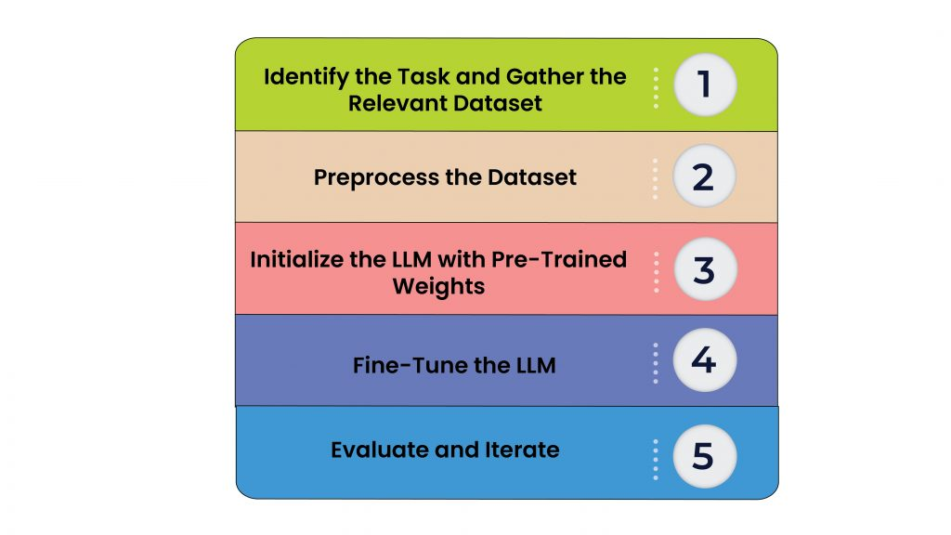
Finetuning
Fine-tuning a large language model involves adjusting and adapting a pre-trained model to perform specific tasks or to cater to a particular domain more effectively. The process usually entails training the model further on a smaller, targeted dataset that is relevant to the desired task or subject matter.
The principle behind fine-tuning originates from the broader concept of transfer learning, a common practice in machine learning.

Slide 45
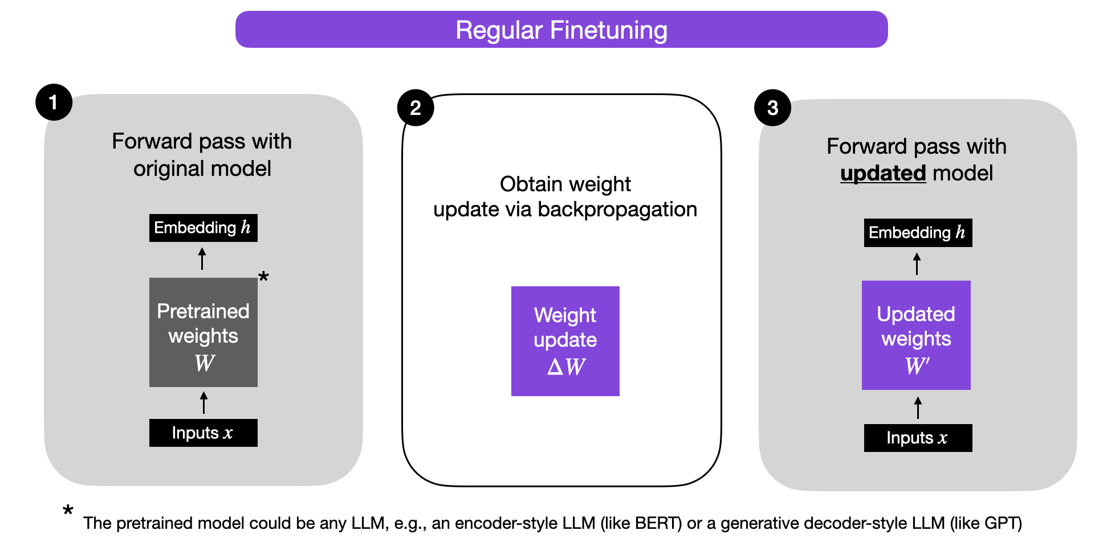
Finetuning Workflow
Traditional fine tuning is a machine learning technique that involves training a pre-trained model for specific task with new data. The entire pre-trained model is usually trained in fine tuning, including all its layer and parameters
It is a time-consuming and computationally expensive process, especially for large models.

Slide 46
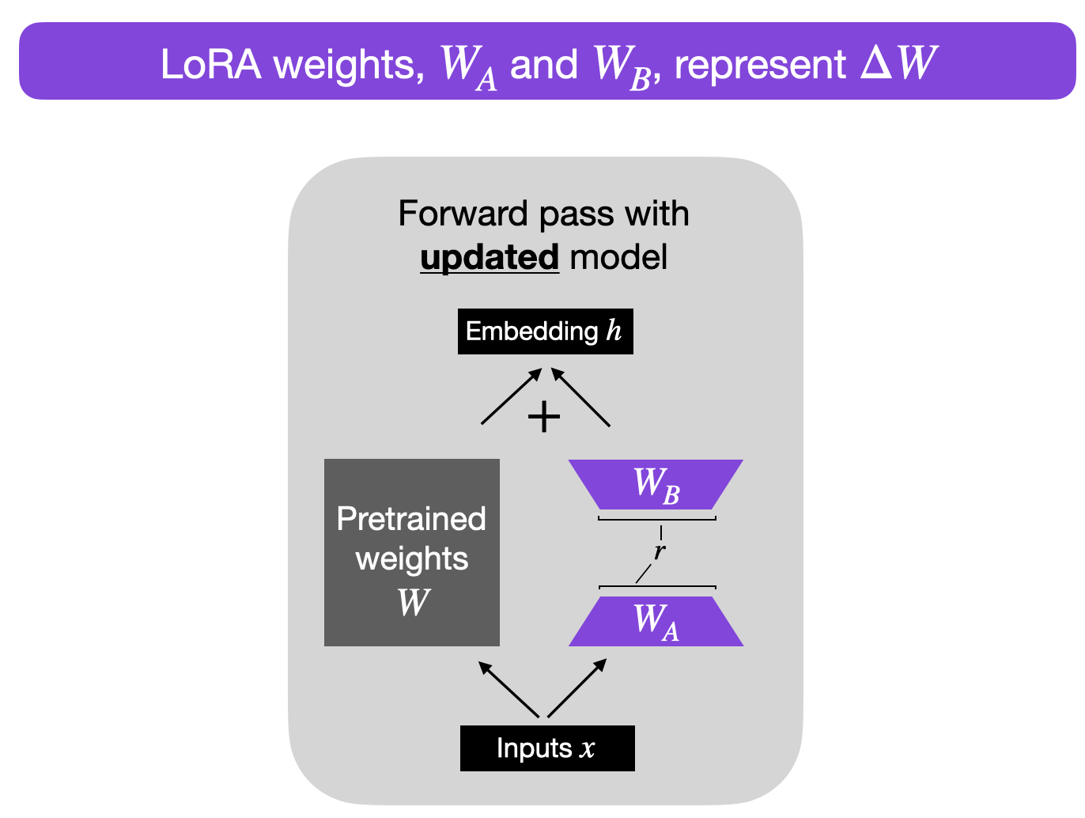
LoRA Based Fine Tuning
LoRA (Low-Rank Adaptation), proposed in a paper by researchers at Microsoft, suggests that when fine-tuning an LLM for a downstream task, you don’t need the full-rank weight matrix. They proposed that you could preserve most of the learning capacity of the model while reducing the dimension of the downstream parameters.
LoRA adds a tiny number of trainable parameters, i.e., adapters, for each layer of the LLM and freezes all the original parameters. For fine-tuning, we only must update the adapter weights which significantly reduces the memory footprints

Slide 47
QLORA based Fine Tuning
QLoRA, or Quantized Low Rank Adapters, is a new approach to fine-tuning large language models (LLMs) that uses less memory while maintaining speed. QLoRA works by first quantizing the LLM to 4-bits, reducing the model’s memory footprint significantly.
The quantized LLM is then fine-tuned using the Low Rank Adapters (LoRA) approach. LoRA enables the refined model to preserve the majority of the accuracy of the original LLM while being significantly smaller and quicker.
QLoRA is based on the assumption that the bulk of information in a large language model is contained in the model’s weights, and that the remaining information may be approximated without affecting the model’s accuracy much. QLoRA quantizes the LLM weights to 4-bits, reducing the model’s memory footprint by 8x.

Slide 48
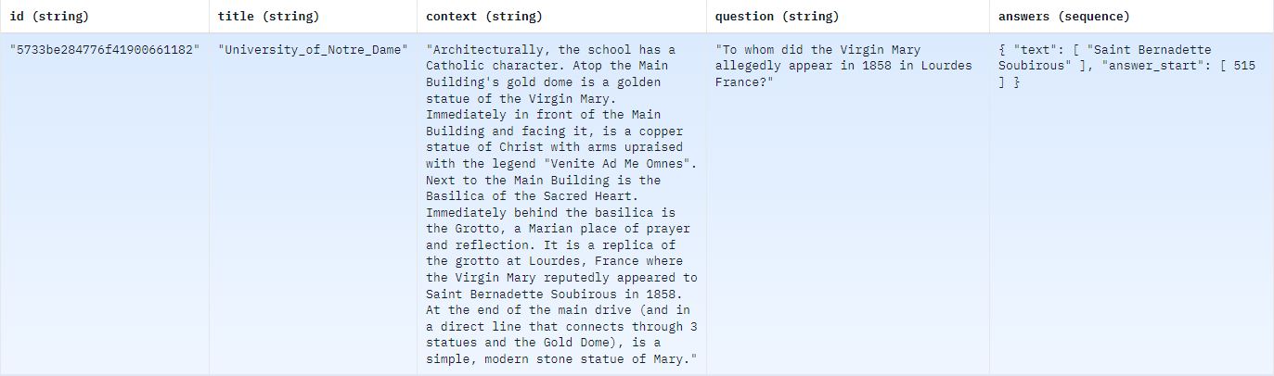
About Dataset (SQuAD)
Stanford Question Answering Dataset (SQuAD) is a reading comprehension dataset, consisting of questions posed by crowd workers on a set of Wikipedia articles, where the answer to every question is a segment of text, or span, from the corresponding reading passage, or the question might be unanswerable. SQuAD2.0 tests the ability of a system to not only answer reading comprehension questions, but also abstain when presented with a question that cannot be answered based on the provided paragraph.
SQUAD Dataset consist of 100K Samples - (train(87.6k rows) and validation (10.6k rows)
https://huggingface.co/datasets/squad

Slide 49
Fine tuned Models for Invoice Data

Slide 50
google/flan-t5-base | Traditional Fine-tuning | Fine-tuning with_LORA | Fine-tuning with_QLORA
What is the Invoice number?​ | INV-3337 | INV-3337 | The Invoice Number is INV-3337.
What is the Invoice date?​ | January 25, 2016 | January 25, 2016 | The Invoice Date is January 31, 2016
What is the total amount?​ | $85.00 Tax $8.50 | $85.00 | The total amount is $93.50.
State the From address of Invoice?​ | DEMO - Sliced Invoices Suite 5A-1204 123 Somewhere Street | DEMO - Sliced Invoices Suite 5A-1204 123 Somewhere Street | DEMO - Sliced Invoices Suite 5A-1204 123 Somewhere Street
State the To address of Invoice?​ ​ | 123 Somewhere Street Your City AZ 12345 | 123 Somewhere Street Your City AZ 12345 | 123 Somewhere Street, Your City AZ.
What is the order number?​ | 12345 | 12345 | Order number: 12345
Score​ | ​8 | ​8 | 8.5

Slide 51
declare-lab/flan-alpaca-base | Traditional Fine-tuning | Fine-tuning with_LORA | Fine-tuning with_QLORA
What is the Invoice number?​ | INV-3337 | The Invoice Number is 12345. | The Invoice Number is 12345.
What is the Invoice date?​ | January 25, 2016 | The Invoice Date is January 25, 2016. | The Invoice Date is January 25, 2016
What is the total amount?​ | $93.50 | The total amount is $1,075. | The total amount is $93.50.
State the From address of Invoice?​ | DEMO - Sliced Invoices Suite 5A-1204 123 Somewhere Street | DEMO - Sliced Invoices Suite 5A-1204 123 Somewhere Street | DEMO - Sliced Invoices Suite 5A-1204 123 Somewhere Street
State the To address of Invoice?​ ​ | 123 Somewhere Street, | 123 Somewhere Street, Your City AZ. | 123 Somewhere Street, Your City AZ.
What is the order number?​ | 12345 | 12345 | Order number: 12345
Score​ | ​8.5 | ​8.5 | 8.7

Slide 52
Bert | Traditional Fine-tuning | Fine-tuning with_LORA | Fine-tuning with_QLORA
What is the Invoice number?​ | INV-3337 | INV-3337 | INV-3337
What is the Invoice date?​ | January 25, 2016 | January 25, 2016 | January 25, 2016
What is the total amount?​ | $93.50 | $93.50 | $93.50
State the From address of Invoice?​ | DEMO - Sliced Invoices Suite 5A-1204 123 | DEMO - Sliced Invoices Suite 5A-1204 123 | DEMO - Sliced Invoices Suite 5A-1204 123
State the To address of Invoice?​ ​ | Your City AZ 12345 admin@slicedinvoices.com | 123 Somewhere Street, Your City AZ. | 123 Somewhere Street, Your City AZ.
What is the order number?​ | 12345 | 12345 | 12345
Score​ | ​8.5 | ​8.7 | 8.7

Slide 53
Distilbert | Traditional Fine-tuning | Fine-tuning with_LORA | Fine-tuning with_QLORA
What is the Invoice number?​ | 3337 | INV-3337 | INV-3337
What is the Invoice date?​ | January 25, 2016 | January 25, 2016 | January 25, 2016
What is the total amount?​ | $93.50 | $93.50 | $93.50
State the From address of Invoice?​ | DEMO - Sliced Invoices Suite 5A-1204 123 | DEMO - Sliced Invoices Suite 5A-1204 123 | DEMO - Sliced Invoices Suite 5A-1204 123
State the To address of Invoice?​ ​ | Your City AZ 12345 admin@slicedinvoices.com | Your City AZ 12345 admin@slicedinvoices.com | Your City AZ 12345 admin@slicedinvoices.com
What is the order number?​ | 12345 | 12345 | 12345
Score​ | ​7.9 | ​8.6 | 8.6

Slide 54
Bloom 560m | Traditional Fine-tuning | Fine-tuning with_LORA | Fine-tuning with_QLORA
What is the Invoice number?​ | INV-3337 | INV-3337 | INV-3337
What is the Invoice date?​ | January 25, 2016 | January 25, 2016 | January 25, 2016
What is the total amount?​ | $93.50 | $93.50 | $93.50
State the From address of Invoice?​ | DEMO - Sliced Invoices Suite 5A-1204 123 Somewhere Street YourCity AZ12345 | DEMO - Sliced Invoices Suite 5A-1204 123 Somewhere Street YourCity AZ12345 admin@slicedinvoices.com | DEMO - Sliced Invoices Suite 5A-1204
State the To address of Invoice?​ ​ | 123 Somewhere Street Your City AZ 12345 | ​Test Business 123 Somewhere St Melbourne, VIC 3000 | Test Business 123 Somewhere St Melbourne, VIC 3000
What is the order number?​ | 12345 | 12345 | 12345
Score​ | ​8.4 | 8.7​ | 8.2

Slide 55
Fine tuned for Documents

Slide 56
google/flan-t5-base | Traditional Fine-tuning | Fine-tuning with_LORA | Fine-tuning with_QLORA
What is Artificial Intelligence? | ​simulation of human intelligence in machines that are programmed to think and act like humans | ​simulation of human intelligence in machines that are programmed to think and act like humans | Artificial Intelligence is the simulation of human intelligence in machines that are programmed to think and act like humans
What is Intelligence? | The ability to learn and solve problems | The ability to learn and solve problems | Intelligence is the ability to learn and solve problems
What is Intelligence is composed of? ​ | ​Reasoning, Problem-Solving, Perception, Linguistic Intelligence | Reasoning, Learning, Problem-Solving, Perception, Linguistic Intelligence | Intelligence is composed of: • Reasoning • Learning • Problem-Solving , Linguistic Intelligence
List any Four uses of Artificial Intelligence? | 1.Healthcare 2. Finance 3. Banking 4. Manufacturing | 1. Healthcare 2. Finance 3. Banking 4. Manufacturing | 1. Healthcare 2. Finance 3. Retail 4.Manufacturing5.Transportation 6. Banking 7. Retail 8. Customer service 9. Banking
Need of Artificial Intelligence? | ​human intelligence | ​human intelligence | The need for Artificial Intelligence is a growing need for more efficient and effective solutions
Explain Robotics technology in Artificial Intelligence? | ​Robots | Robots | Robotics technology in Artificial Intelligence is a technology that uses robotics to perform
Score​ | ​7.2 | 7.2​ | 7.5

Slide 57
declare-lab/flan-alpaca-base | Traditional Fine-tuning | Fine-tuning with_LORA | Fine-tuning with_LORA
What is Artificial Intelligence? | simulation of human intelligence | ​Artificial Intelligence (AI) refers to the simulation of human intelligence in machines that are programmed to think and act like humans. | AI is the development of algorithms and computer programs that can perform tasks that typically require human intelligence.
What is Intelligence? | The ability to learn and solve problems | the ability to learn and solve problems. | Intelligence is the ability to learn and solve problems. It is the development of algorithms
What is Intelligence is composed of? | Reasoning,• Problem -Solving • Perception • Linguistic Intelligence. | Reasoning • Problem -Solving • Perception • Linguistic Intelligence. | Intelligence is composed of: • Reasoning • Learning • Problem-Solving
List any Four uses of Artificial Intelligence? | 1. Healthcare 2. Finance 3. Banking 4. Manufacturing | 1. Healthcare 2. Finance 3. Banking 4. Manufacturing | 1. Healthcare 2. Finance 3. Retail 4. Manufacturing 5. Transportation 6. Banking 7. Retail 8. Customer service 9. Banking
Need of Artificial Intelligence? | AI has the potential to revolutionize many industries and has a wide range of applications | AI is used for product recommendations, price optimization. | 1. Improved efficiency 2. Improved decision-making 3. Improved accuracy 4. Improved personalization
Explain Robotics technology in Artificial Intelligence? | Robotics technology in Artificial Intelligence is a technology that uses robotics to perform | Robotics technology in Artificial Intelligence is a technology that uses robotics to perform | AI is a subfield of AI that uses algorithms to learn and act like humans.
Score​ | ​6.9 | 7.2​ | 8

Slide 58
BERT | Traditional Fine-tuning | Fine-tuning with_LORA | Fine-tuning with_QLORA
What is Artificial Intelligence? | simulation of human intelligence | Artificial Intelligence (AI) refers to the simulation of human intelligence in machines that are programmed to think and act like humans. It involves the development of algorithms and computer programs that can perform tasks that typically require human intelligence such as visual perception, speech recognition, decision -making, and language translation. | Artificial Intelligence (AI) refers to the simulation of human intelligence in machines that are programmed to think and act like humans. It involves the development of algorithms and computer programs that can perform tasks that typically require human intelligence such as visual perception, speech recognition, decision -making, and language translation.
What is Intelligence? | The ability to learn and solve problems | the ability to learn and solve problems. | Intelligence is the ability to learn and solve problems. It is the development of algorithms
What is Intelligence is composed of? | Reasoning | Reasoning, Learning, Problem-Solving, Perception, Linguistic Intelligence | Reasoning, Learning, Problem-Solving, Perception, Linguistic Intelligence
List any Four uses of Artificial Intelligence? | 1. Healthcare 2. Finance 3. Banking 4. Manufacturing | 1. Health care 2. Finance 3. Banking 4. Manufacturing | 1. Health care 2. Finance 3. Banking 4. Manufacturing
Need of Artificial Intelligence? | AI has the potential to revolutionize many industries and has a wide range of applications | AI has the potential to revolutionize many industries and has a wide range of applications | AI has the potential to revolutionize many industries and has a wide range of applications
Explain Robotics technology in Artificial Intelligence? | Robotics technology in Artificial Intelligence is a technology that uses robotics to perform | Robotics technology in Artificial Intelligence is a technology that uses robotics to perform | Robotics technology in Artificial Intelligence is a technology that uses robotics to perform
Score​ | ​7 | 8.2​ | 8.2

Slide 59
Distilbert | Traditional Fine-tuning | Fine-tuning with_LORA | Fine-tuning with_QLORA
What is Artificial Intelligence? | simulation of human intelligence | Artificial Intelligence (AI) refers to the simulation of human intelligence in machines that are programmed to think and act like humans. It involves the development of algorithms and computer programs that can perform tasks that typically require human intelligence such as visual perception, speech recognition, decision -making, and language translation | Artificial Intelligence (AI) refers to the simulation of human intelligence in machines that are programmed to think and act like humans. It involves the development of algorithms and computer programs that can perform tasks that typically require human intelligence such as visual perception, speech recognition, decision -making, and language translation
What is Intelligence? | The ability to learn and solve problems | The ability to learn and solve problems | The ability to learn and solve problems
What is Intelligence is composed of? | Reasoning • Learning • Problem -Solving • Perception • Linguistic Intelligence. | Reasoning • Learning • Problem -Solving • Perception • Linguistic Intelligence. | Reasoning • Learning • Problem -Solving • Perception • Linguistic Intelligence
List any Four uses of Artificial Intelligence? | 1. Healthcare 2. Finance 3. Banking 4. Manufacturing | 1. Healthcare 2. Finance 3. Banking 4. Manufacturing | 1. Healthcare 2. Finance 3. Banking 4. Manufacturing
Need of Artificial Intelligence? | AI has the potential to revolutionize many industries and has a wide range of applications | AI has the potential to revolutionize many industries and has a wide range of applications | AI has the potential to revolutionize many industries and has a wide range of applications
Explain Robotics technology in Artificial Intelligence? | Robotics technology in Artificial Intelligence is a technology that uses robotics to perform | It involves the development of algorithms and computer programs that can perform tasks that typically require human intelligence such as visual perception, speech recognition, decision -making, and language translation. . | It involves the development of algorithms and computer programs that can perform tasks that typically require human intelligence such as visual perception, speech recognition, decision -making, and language translation.
Score​ | ​7 | 7.9​ | 7.9

Slide 60
Bloom 560m | Traditional Fine-tuning | Fine-tuning with_LORA | Fine-tuning with_QLORA
What is Artificial Intelligence? | Artificial Intelligence (AI) refers to the simulation of human intelligence in machines that are programmed to think and act like humans. It involves the development of algorithms and computer programs that can perform tasks that typically requirehuman intelligence such as visual perception, speech recognition, decision -making, and language translation. | Artificial Intelligence (AI) refers to the simulation of human intelligence in machines that are programmed to think and act like humans. It involves the development of algorithms and computer programs that can perform tasks that typically require human intelligence such as visual perception, speech recognition, decision -making, and language translation | Artificial Intelligence (AI) refers to the simulation of human intelligence in machines that are programmed to think and act like humans. It involves the development of algorithms and computer programs that can perform tasks that typically require human intelligence such as visual perception, speech recognition, decision -making, and language translation
What is Intelligence? | Intelligence is the ability to learn and solve problems. | The ability to learn and solve problems | Intelligence is the ability to learn and solve problems.
What is Intelligence is composed of? | Intelligence is composed of: • Reasoning • Learning • Problem -Solving • Perception • Linguistic Intelligence. | Intelligence is composed of: • Reasoning • Learning • Problem -Solving • Perception • Linguistic Intelligence. | Intelligence is composed of: • Reasoning • Learning • Problem -Solving • Perception • Linguistic Intelligence.
List any Four uses of Artificial Intelligence? | 1. Health care 2. Finance 3. Banking 4. Manufacturing | 1. Healthcare: AI is used for medical diagnosis, drug discovery, and predictive analysis of diseases. | 1. Health care 2. Finance 3. Banking 4. Manufacturing
Need of Artificial Intelligence? | The need for Artificial Intelligence is a growing need for more efficient and effective solutions to complex problems. | AI has the potential to revolutionize many industries and has a wide range of applications | The need for Artificial Intelligence is a growing need for more efficient and effective solutions to complex problems.
Explain Robotics technology in Artificial Intelligence? | It involves the development of algorithms and computer programs that can perform tasks that typically require human intelligence such as visual perception, speech recognition, decision -making, and language translation. . | Robotics technology in Artificial Intelligence is a technology that uses robotics to perform | It involves the development of algorithms and computer programs that can perform tasks that typically require human intelligence such as visual perception, speech recognition
Score​ | 8.5​7 | 8.2​ | 8.3

Slide 61
Fine tuned for Generic Question

Slide 62
google/flan-t5-base | Traditional Fine-tuning | Fine-tuning with_LORA | Fine-tuning with_QLORA
What is the capital of France? | london | The capital of France is london. | The capital of France is london.
How many days are there in a week? | 7 | There are 7 days a week. | There are seven days a week.
What is the largest planet in our solar system? | venus | The largest planet in our solar system is venus. | The largest planet in our solar system is venus.
What is the tallest mountain in the world? | sahara | The tallest mountain in the world is sahara. | The tallest mountain in the world is sahara.
What is the main language in India? | tamil | The main language in India is Hindi. | The main language in India is Hindi.
Who is the author of Harry Potter book series? | Harry Potter | The author of Harry Potter book series is Harry Potter. | The author of Harry Potter book series is Harry Potter.
Score​ | ​6 | ​7 | ​7

Slide 63
declare-lab/flan-alpaca-base | Traditional Fine-tuning | Fine-tuning with_LORA | Fine-tuning with_QLORA
What is the capital of France? | Paris | The capital of France is Paris. | The capital of France is Paris.
How many days are there in a week? | There are 7 days a week. | There are 7 days a week. | There are approximately 365 days in a week.
What is the largest planet in our solar system? | Mercury | The largest planet in our solar system is Mercury. | The largest planet in our solar system is Mercury, which is the planet closest to Earth
What is the tallest mountain in the world? | Mount Everest | The tallest mountain in the world is Mount Everest, located in the Himalayas, | The tallest mountain in the world is Mount Everest, located in Nepal..
What is the main language in India? | The main language in India is Hindi. | The main language in India is Hindi. | The main language in India is Hindi.
Who is the author of Harry Potter book series? | Harry Potter | The author of Harry Potter book series is J.K. Rowling. | The author of Harry Potter and the Philosopher's Stone series is Harry Potter.
Score​ | ​7 | 7.5​ | 7.5

Slide 64
Bloom 560 M | Traditional Fine-tuning | Fine-tuning with_LORA | Fine-tuning with_QLORA
What is the capital of France? | Paris | The capital of France is Paris. | The capital of France is Paris.
How many days are there in a week? | There are 7 days a week. | There are 7 days a week. | There are 7 days a week.
What is the largest planet in our solar system? | Mercury | The largest planet in our solar system is Mercury. | The largest planet in our solar system is Mercury.
What is the tallest mountain in the world? | Mount Everest | The tallest mountain in the world is Mount Everest, located in the Himalayas, | The tallest mountain in the world is Mount Everest, located in the Himalayas
What is the main language in India? | The main language in India is Hindi. | The main language in India is Hindi. | The main language in India is Hindi.
Who is the author of Harry Potter book series? | The author of Harry Potter book series is J.K. Rowling. | The author of Harry Potter book series is J.K. Rowling. | The author of Harry Potter book series is J.K. Rowling
Score​ | 7.5​ | ​8.7 | 8.7

Slide 65
Traditional Finetuning - Performance
Model Name​ | Parameter Size | Model Size | Number of parameters trained | Performance​
 |  |  |  | RAM (13GB) | GPU (15GB)​ | Disk (78.2GB)​ | Time per Epoch (min)
google/flan-t5-base | 248M | 0.9224 GB | 247577856 | ​4.09 | 9.2 | ​2.96 | 128:57
declare-lab/flan-alpaca-base | 248M | 0.9224 GB | 247577856 | 4 | 9.2 | 2.88 | 125:22
bert-base-uncased | 110M | 0.4080 GB | 109,839,732 | 3.18 | 8.7 | 1.89 | 84:12
distilbert-base-uncased | 67M | 0.2473 GB | 66,585,602 | 2.8 | 5.4 | 1.4 | 62:33
bigscience/bloom-560m | 569M | 2.0833 GB | 560,001,024 | ​8.7 | ​11.2 | ​4.56 | 140:56

Slide 66
Finetuning with Lora - Performance
Model Name​ | Parameter Size | Model Size | Number of parameters trained | LoRa Performance​
 |  |  |  | RAM (13GB) | GPU (15GB)​ | Disk (78.2GB)​ | Time per Epoch (min)
google/flan-t5-base | 248M | 0.3830 GB | 1,769,472 | ​3.87 | 3.5 | 1.88 | 54:47
declare-lab/flan-alpaca-base | 248M | 0.3830 GB | 1,769,472 | 3.89 | 3.5 | 1.84 | 52:16
bert-base-uncased | 110M | 0.1254 GB | 442,368 | 3.2 ` | 2.3 | 1.52 | 28:41
distilbert-base-uncased | 67M | 0.0843 GB | 221,184 | 2.4 | 1.8 | 1.24 | 20:55
bigscience/bloom-560m | 569M | 0.7613 GB | 786,432 | 8.2 | 11.1 | 2.12 | 62:44

Slide 67
Finetuning with QLoRa - Performance
Model Name​ | Parameter Size | Model Size | Number of parameters trained | QLoRa Performance​
 |  |  |  | RAM (13GB) | GPU (15GB)​ | Disk (78.2GB)​ | Time per Epoch (min)
google/flan-t5-base | 248M | 0.3075 GB | 884,736 | ​3.9 GB | 2.2GB | ​1.63 | 47:02
declare-lab/flan-alpaca-base | 248M | 0.3075 GB | 884,736 | 3.85 GB | 2.2 GB | 1.62 | 44:50
bert-base-uncased | 110M | 0.0855 GB | 442,368 | 3.2 | 1.2 | 1.44 | 18:83
distilbert-base-uncased | 67M | 0.0643 GB | 221,184 | 2.8 | 1.1 | 1.22 | 14:11
bigscience/bloom-560m | 569M | 0.6199 GB | 786,432 | 4.06 | 10.7 | 1.97 | 54:50

Slide 68
Conclusion
For this study have taken Eleven open-source Large Language Model from hugging face hub
And tried Question answering for Document and invoice dataset with the help of Langchain framework.
After observing the LLM's Outcome hence we concluded that fine tuning is required so worked on fine tuning the some of the efficient LLM based on performance.
While fine tuning we have used we following three methods Traditional way and using Parameter efficient fine tuning – LoRA And QLoRA.
Where we have compared both the fine-tuning methods while observing the fine-tuned LLM it have been significantly improved and produced a greater impact on its performance.
After fine tuning we have developed a UI using Streamlit with Langchain and LLM as backend so that it could be easily accessible by end users.

